Slide 1
COMP90018 Mobile Computing Systems Programming
Prof. Vassilis Kostakos

Slide 2
Logistics
Lecturers
Vassilis Kostakos <vassilis.kostakos@unimelb.edu.au>
Tilman Dingler <tilman.dingler@unimelb.edu.au>
Tutors
Guanli Liu
Harshit Sethi
Ransi De Silva
Chaofan Wang
Mohammet Atiq
Yuan Wang

Slide 3
Location and Time
Lectures
Tuesdays 12:00 pm - 2:00 pm
PAR-The Spot-B01 (Copland Theatre)
Workshops
Multiple days (see official timetable)
Hands on tutorials
Help with your project from mid-semester

Slide 4
Schedule
Week | Lecture | Workshop
1 | Introduction | Compile your first Android app
2 | User Interfaces | Build a GUI for mobile & smartwatch
3 | Processing sensor data | Threads, services, sensors. Build a compass GUI.
4 | Location-based Services | Sensors and GPS
5 | Context-aware computing | Data storage
6 | Introduction to the Project | Connectivity and Firebase
7 | Guest Lecture | Help with project
8 | Ethnography & evaluation | Help with project
9 | Privacy | Help with project
10 | Advanced topics | Help with project
11 | Field studies | Help with project
12 | Revision lecture | Help with project

Slide 5
Assessment
Group assessment
Research: 20% - Due week 5
Report – 3000 words: 15%
Video (upload on youtube) – 5 minutes: 5%
Project: 20% - Due week 12
30 hours work per student
Individual assessment
Exam: 60% - During exam period

Slide 6
Research - Video
Group presentation of 5 minutes
Choose cool new applications, concepts or ideas that can be shown in less than 5 minutes by a short video (of your own)
Has to be related to mobile computing
Picking a topic
Up to your group
Confirm/check with tutors

Slide 7
Research - Report
Structure (suggestion)
Title, authors, abstract, HTTP link to video (1 page)
Introduction (2 pages)
Topic and critical analysis (6-7 pages in two or three sections)
Conclusions and future directions (1-2 pages)
References and sources (1 page)
Itemised contributions by each member (1 page)
Length
Maximum 14 pages, 3000 words
Submission
PDF format
Via LMS

Slide 8
Project
Programming environment
Android, Java
Hands on experience
Topic: Develop a context-aware mobile application
Must run on phone
Must use multiple sensors
Must access information from the Internet/cloud
Must be usable
Must be innovative
Must not be trivial to build (not a weekend project)

Slide 9
Project examples
You can build a game
Flappy Bird with Sensory input and a game server
You can build a utility app
Smart City app: use publicly available APIs (e.g. public transport) and your GPS location, and do something interesting
You can build a social app
Foursquare/friends nearby, sharing your context (e.g. my phone is set to silent), location, nearby Points-of-Interest.

Slide 10
What is Mobile Computing?

Slide 11
What is Mobile Computing?
Who is mobile?
The user
What is mobile?
The device
The software agent (or process)
Assumption
Network access is availabe (not necessarily always and from anywhere)

Slide 12
What is Mobile Computing?
Vijay Kumar
Information management platform free from spatial and temporal constraints
Sandeep Jain
Technologies that enable people to access network services anyplace, anytime, and anywhere
Lata Narayanan
Computing paradigm that permits users with portable computers to retain their (wireless) network connection even when mobile

Slide 13
Topics in Mobile Computing
Information management
Location-based services
Mobile data management
Technologies
WPANs (Bluetooth), WLANs, WANs, RFID, GPS, ...
Routing in MANETs, mobile IP, ...
Computing paradigm
Developing software for mobile devices
UI design, thin/fat client, ...

Slide 14
4 Challenges of Mobile Computing
George H. Forman and John Zahorjan
Communication
Mobility
Portability
Social impact
Source: Forman and Zahorjan (1994). The Challenges of Mobile Computing, Computer, 27(4)

Slide 15
Wireless Communication
More frequent disconnections
Lower bandwidth
Higher latency
Variation in available bandwidth
Greater network heterogeneity
Increased security risks

Slide 16
Mobility
Address migration
Mobile devices used different (IP) addresses
Selective broadcast, central services, home base, forwarding pointers
Location dependent information
Information request depends on the location of the device
Migrating locality
Connections should be dynamically transferred to servers that are (geographically) closer

Slide 17
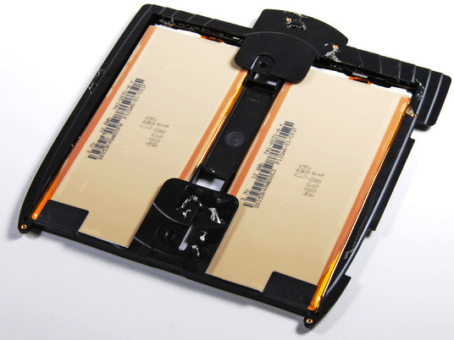
Portability I
Energy usage
Batteries are the most important source of weight (e.g., iPad more than 20% (148g),
Power consumption is proportional to CV²F
C: capacitance can be reduced by VLSI design
V: voltage can be reduced by smaller structures
F: clock frequency

Slide 18
Portability II
Risk to data
Portable devices are more vulnerable to loss or damage
Resource-poor relative to static devices
Given a certain cost and level of technology, processor speed, memory size, and storage capacity are always smaller compared to their static counterparts
Small user interface

Slide 19
Social Impact
Privacy
Security
Behaviour

Slide 20
Wired versus Wireless Networks
Wired Networks
Wireless Networks
Low bandwidth
High bandwidth
Low bandwidth variability
Possibility to listen on wire
Physical access (security)
Low delay
Connected operation
High bandwidth variability
Hidden terminal problem
Requires proximity
High delay
Disconnected operation

Slide 21
Milestones for Mobile Systems
1928
First mobile radio used by the Detroit Police Department
1940s
Limited cellular networks
Implementation of the first mobile radio system to connect with a fixed telephone number
1950s
Bell Labs tests cellular techniques
1970s
Cellular service proposed by AT&T

Slide 22
Mobile Computing and ...
Context-awareness
Obtain information from the environment and dynamically configure services
Ubiquitous computing = ?
Mobile computing + context awareness
Wearable computing
Mark Weiser’s vision of ubiquitous computing
The most profound technologies are those that disappear. They weave themselves into the fabric of everyday life until they are indistinguishable from it.

Slide 23
Are we there yet ...
Digital mobile phone networks
Handheld devices
GPS
WLAN
To come
RFID
WiMaX
UWB

Slide 24
Smartphones

Slide 25
Mobile Computing Devices
Mobile Devices
Mobile Phone
PDA
Smart phone
Audio player
Video player
Digital Camera
Tablet PC
Laptop
Game Console
In Car Navigation

Slide 26
Overview of Handheld Devices
Handheld (device)
Portable device that supports wireless communications or information management (or both)
Mobile phone
Portable telecommunication device
PDA (Personal Digital Assistant)
Handheld for personal information management (PIM)
Smartphone
Handheld combining mobile phone and PDA functions

Slide 27
Smartphones
Smart phones
PDAs
Audio player
Video player
Digital Camera
Mobile phone
Game Console
Navigation
Fitness Tracking
Payment

Slide 28
Ubiquity of Mobile Phones
Status quo
4.8 billion mobile phone users*
Several million PDAs (no precise numbers)
Number of mobile phones ≫ number of PDAs
Number of mobile phones > number of PCs!
Smartphones integrate PDA functionality
Are likely to serve as a convergence device
*http://www.statista.com/statistics/274774/forecast-of-mobile-phone-users-worldwide/

Slide 29
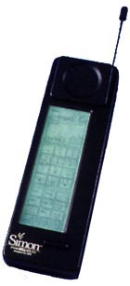
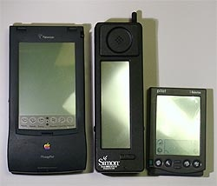
The First Smartphone
Simon
Developed by IBM in 1992, distributed by BellSouth in 1993 (original price: USD 899)
Capabilities: address book, appointment calendar, calculator, sketchpad, world clock
Communication: email (no Internet), fax, phone
GUI: icons, background patterns, round rectangles
B&W display (160 x 293)
Quite large and heavy
Source http://cdecas.free.fr/computers/pocket/simon.php

Slide 30
Smartphone Applications I
Digital purchases
Download and use products immediately
Ringtones, games, …
Mobile shopping
Price comparison
Product information
Mobile advertising
User profiles  personalized offers
But: unsolicited messages

Slide 31
Smartphone Applications II
Information services
Ubiquitous access to information
Stock quotes, weather information, news, …
Location-based services
Where am I, what is nearby, how do I get from A to B?
Context-aware applications
Advanced wireless and 3G services
Access to multimedia files (podcasting)
Mobile TV

Slide 32
The Future of Smartphones I
Mobile banking
Access bank accounts from everywhere (Internet banking on the go)
Using a mobile for payments (digital cash)
Speech recognition
Voice dialing -> verification, text input, translation, …
Barcode reader
Dedicated or integrated with the camera
Shopping, information, payment

Slide 33
The Future of Smartphones II
Increase range of wireless services
WiMax
Peer to peer phones
Integration with sensors
GPS, accelerometer, temperature, …
Overcome limitations in screen size
Folding e-paper
Built-in projectors
Smart walls

Slide 34
Operating Systems
Symbian
Nokia, Panasonic, Siemens AG, Sony Ericsson
Predecessor: EPOC
Pre-emptive multitasking, multithreading, memory protection
Support for C++, Java, Python, …
Windows Mobile
Compact OS based on Microsoft’s Win32 API
Pre-emptive multitasking, multithreading, memory protection
Support for C#, Visual Basic, C++,…

Slide 35
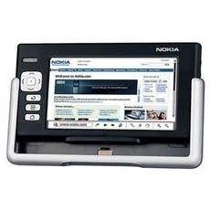
Operating Systems
Linux
Major player (Android)
Pre-emptive multitasking, multithreading, memory protection
Many programming languages
Palm OS
Palmsource
No (per-process) memory protection, no multithreading, no pre-emptive multitasking
Palm OS Cobalt supports multitasking and multithreading
Support for C++, Java, Visual Basic, …
Essentially dead now …

Slide 36
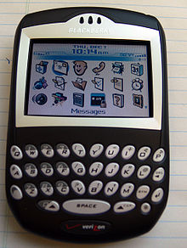
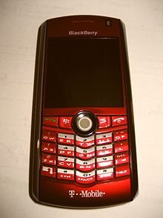
Operating Systems
RIM
Proprietary multi-tasking OS for BlackBerry
Specializes on input devices for mobile phones (keyboard, scroll wheel, track ball)
Good support for Java MIDP

Slide 37
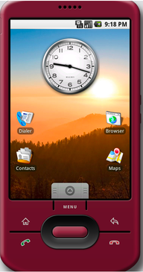
Operating Systems
Android
Not an OS but a software stack that uses Linux
Java (Dalvik virtual machine)
Integrated browser based on open source (WebKit)
See http://www.netmite.com/android/ to run any J2ME or MIDP application

Slide 38
Operating Systems
iPhone OS (Apple)
Unix-like OS, kernel with memory protection, multithreading
Multitasking was limited before iOS 4 to Apple apps (iPod, Mail)

Slide 40
Development Comparison I
 | Symbian | Java ME | Python | .Net Compact | Micro-browser Based | iPhone OS | Android
Language | C++ | Java | Python | C#, VB | XHTML, WML | Objective C | Java
Learning Curve | Steep | Average | Excellent | Average | Varies | Steep | Average
Debugger | Good | Excellent | Average | Excellent | Good | Excellent | Excellent
Emulator available | Free Emulator | Free Emulator | Add-on to Nokia Emulator | Included in Windows Mobile 7 | Many | Yes (Xcode) | Free Emulator
IDE | Many choices | Eclipse, WTK, NetBeans | Several & Eclipse | Visual Studio 2010 | Many | Xcode | Eclipse, Undroid (NetBeans)
Develop-ment Cost | Varies | Free | Free | Free for basic tools | Free | Free/$99 | Free/$25
Source: http://en.wikipedia.org/wiki/Mobile_development

Slide 41
Development Comparison II
 | Symbian | Java ME | Python | .Net Compact | Micro-browser Based | iPhone OS | Android
Cross-Platform Deploym. | Compile per target | Excellent: Bytecode | Nokia Series60 | Windows Pocket PC | Excellent | iPhone, iPod, iPad | Android handsets only
Graphical Interface | 2D, 3D, many widgets, Visual GUI Builder | 2D, 3D, many widgets, Visual GUI Builder | 2D access, some widgets | 2D, many widgets, Visual GUI Builder | N/A | 2D, 3D, widgets, Visual GUI builder | 2D, 3D, widgets, Visual GUI builder
Runtime Speed | Best | Average (Bytecode) | Average (Interpreted) | Good | Average | Best | Good
Market | Extensive | Extensive | Average | Average | Extensive | Extensive | Extensive
Source: http://en.wikipedia.org/wiki/Mobile_development

Slide 42
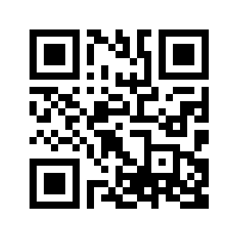
Break! – 15 minutes
During the break, please complete the questionnaire at:
http://go.unimelb.edu.au/jb8r

Slide 43
Ubiquitous Computing

Slide 44
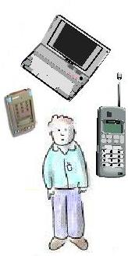
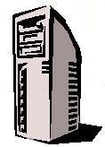
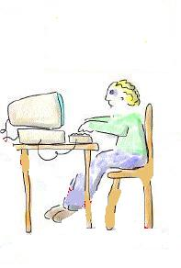
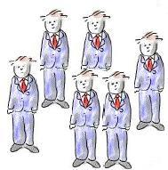
Overview
NUMBER
Vision articulated by Weiser
One computer
One person
One computer
Many people
SIZE
Many computers
One person

Slide 45
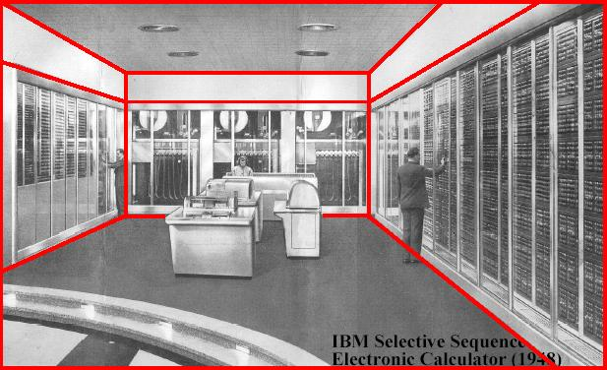
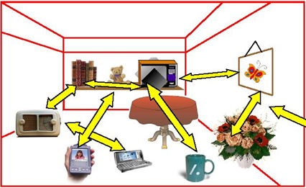
Overview
Computing embedded into everyday objects and environments, enhancing everyday activity

Slide 46
Context-Aware Computing
Context: situational elements relevant to interaction between user, application, environment
Context-awareness: situationally appropriate; apps adapting to context, increasing value to users
Using sensors and actuators to improve human-computer interaction and (computer-mediated) human-human and human-environment interaction
Examples: tour guide, reminders, diary retrieval
Difficulties in building:
Lack of abstractions for acquiring/using context
Lack of design principles
Distributed context sensing

Slide 47
30 Years of Ubicomp Research
Systems-level contributions mostly
Lots of people working on tools for building these types of applications
No doubt that ubicomp will become a reality:
Dystopian a la Minority Report
More utopian
Challenge for ubicomp

Slide 48
Not the Interesting Problem!
Despite all these people building systems, no one using them or liking them
Not a technology issue
Not a development issue
Not a cost issue
So, what is the issue → needs of the user

Slide 49
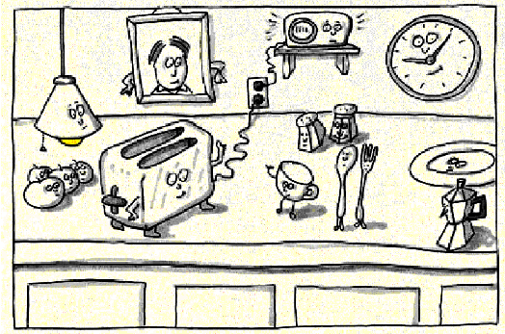
Feeling in Control
Dourish, Abowd and Mynatt, Bellotti and others: lack of control in these environments
Information collected, synthesized and used implicitly
How do I know what’s going on? (feedback)
How do I change what’s going on? (control)
Who gets this information? (privacy)
Is this another way to SPAM me? (overload)
Rich Gold “Dancing Toaster”
Notes:
Didn’t talk about figure

Slide 50
Types of context-aware apps
Various ways of classifying CA software:
Proactive Triggering
e.g. performing some interaction based on environmental perceptions
Streamlining Interaction
Reducing irrelevant information - e.g. travel guide for current location
Memories for past events
Contextual retrieval, e.g. based on spatial or feature-based cues
Reminders for future contexts
e.g. tagging details regarding current context for future access
Optimising patterns of behaviours
e.g. changing interface based on situation (from screen to text-to-voice)
Sharing Experiences
Social networking based on shared contexts

Slide 51
Types of context-aware systems
Passive context-aware systems
New context is presented to the user, to inform them of change
User can then explicitly determine if the use of an application should change
Examples
Changing information regarding environment (weather meters)
Context-based tagging (e.g. by camera)
Active context-aware system
Behaviour of the applications change automatically
Examples
Task filtering (e.g. information filtering, based on current wireless network speed)
Context-based task activation (e.g. routing)
Content adaptation (e.g. for people with disability)

Slide 52
Deriving context (low->high)
New contexts can be created based on sensor data (captured by the device or nearby sensors)
Lower-level raw contexts may need to be processed into higher level contexts
Raw data may need to be scaled or transformed
e.g. electrical signal on a temperature gauge should be converted into a Celsius value...
...or absolute geo-location position should be converted into an address identification of a building
Often this abstraction is more useful
e.g. “this photo was taken at my parents home last christmas”

Slide 53
Deriving context (c1->c2)
Some contexts can be derived from other contexts
By combining several contextual cues, a better understanding of the context can be determined, than considering the cues in isolation
The same cues might mean different things
A user in front of a building may be admiring the architecture, or waiting for a friend
Good for implicit HCI - iHCI systems
e.g. knowing the current location, current time, and having access to the user’s calendar, an app can infer the user’s context
i.e. waiting for a flight, in a meeting, or even en-route, but running late.
Cues may be heterogenous in format
Currently over 100 location coordinate systems are in use
Need mechanisms to resolve heterogeneity within open environments

Slide 54
Deriving context (c1+c2)
Combining several simpler contexts - Context Composition
The joint inference of simpler contexts can imply other contexts
May require interoperation and mediation
Combining homogeneous contexts
Getting several independent values about the same thing
Combining heterogeneous contexts
Additional cues may disambiguate contexts suggested by other cues
Deriving high-level context from lower-level ones
e.g. by knowing someone’s weight and location, an identity may be derived
Deriving low-level contexts from higher-level ones
e.g. a physical location may be derived from more general information such as the street name and building name given by a third party

Slide 55
Further approaches
Consulting a user profile or preferences
Checking the user’s calendar - not always reliable as the user may deviate...
Using historic data
Observing user behaviour and building an implicit user profile
Explicitly ask the user
“Training”
May be annoying to users

Slide 57
Timer
Calories
Calendar
c1 + c2
Step counter
c1 -> c2
Diet
Amplitude
Low->high
Accelerometer

Slide 58
Activity
Make a similar diagram
Objective: the smartphone should detect if you are drunk or not

Slide 59
Summary
Ubiquitous Computing: Interaction design beyond the desktop/mobile
Technology is “everywhere”
The environment becomes smart
Computers can capture context
Computers can infer/calculate context
As a designer, how would you use context in your application.

